Slide 1

STROKE PREDICITON
IBM Supervised Machine Learning: Classification
Kundhan Miriyala

Slide 2

Main Objectives
Develop predictive models for stroke risk using health metrics and demographics.
Strokes are a leading cause of death and disability. They occur due to disrupted blood flow to the brain.
Key Risk Factors
High blood pressure, cholesterol, diabetes, obesity
Smoking, unhealthy diet, physical inactivity, alcohol
Age, family history, gender
Significance
Preventive Healthcare: Early identification for customized prevention.
Resource Allocation: Efficient use of medical resources.
Policy Making: Data-driven strategies to reduce stroke.
Patient Awareness: Educate on risk factors.
This analysis aims to improve outcomes through early detection and targeted intervention.

Slide 3
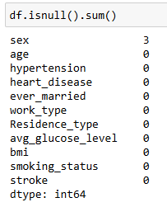
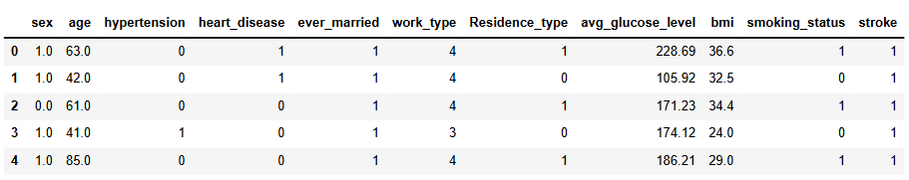
Dataset
SOURCE: Kaggle | health dataset-stoke
The source has three datasets to predict Diabetes, Hypertension and stroke
Dataset consists of 11 columns and 40910 datapoints, out of which 3 NAN values
I just dropped the rows of the NAN values
Top 5 rows of the dataset:

Slide 4
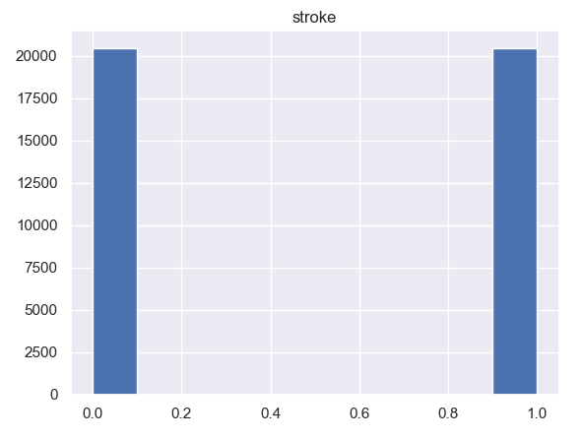
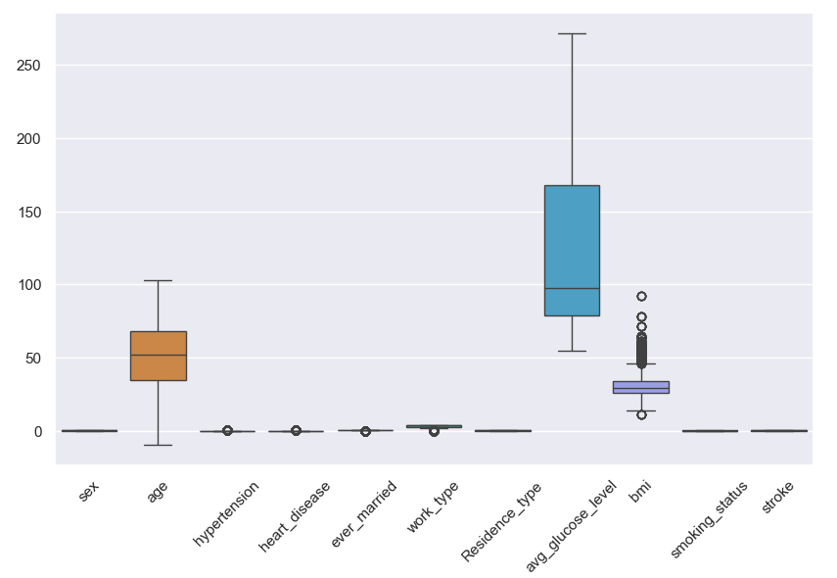
Dataset Brief Description
The dataset is mostly pre-processed, where every columns is suitable for training.
The target variable(stroke) has balanced classes
The data set has some outliers we can visualize it from boxplot

Slide 5
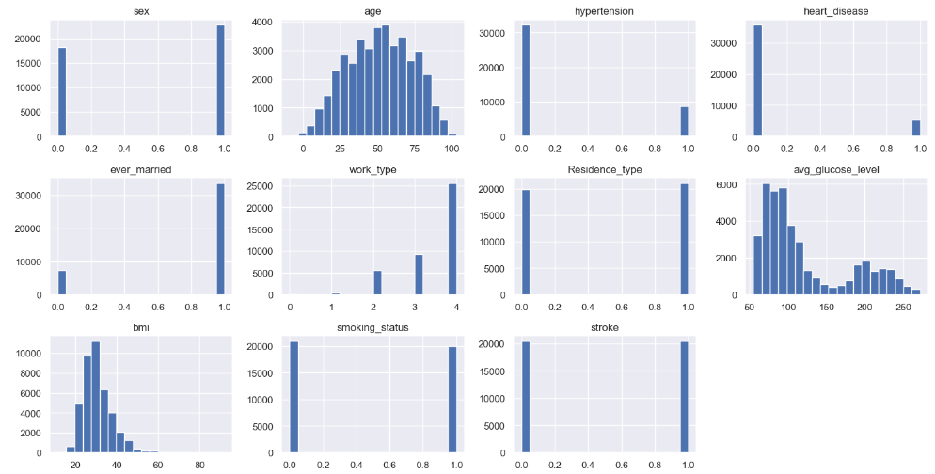
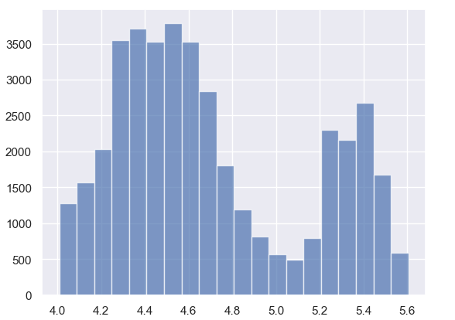
The dataset has most normalized distributions of columns, except avg_glucose_level which is right skewed
Hence ,outliers and these non-normally
distributed has sensitive to models like SVM
I used Log and Square root transformation
After transformation :
I used Log and Square root transformation

Slide 6
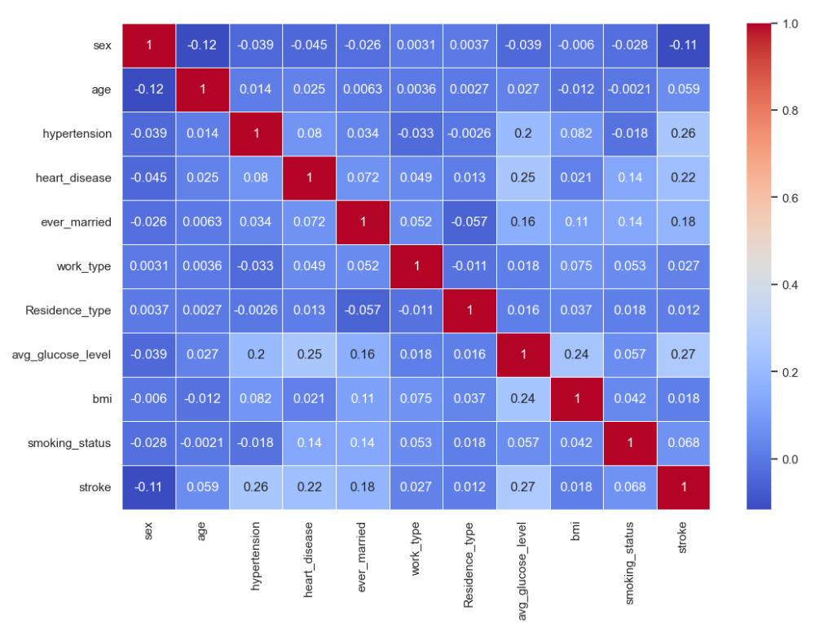
Data Exploration - HEATMAP
The heatmap analysis highlights critical stroke risk factors
Hypertension and average glucose levels show notable positive correlations with stroke occurrences.

Slide 7
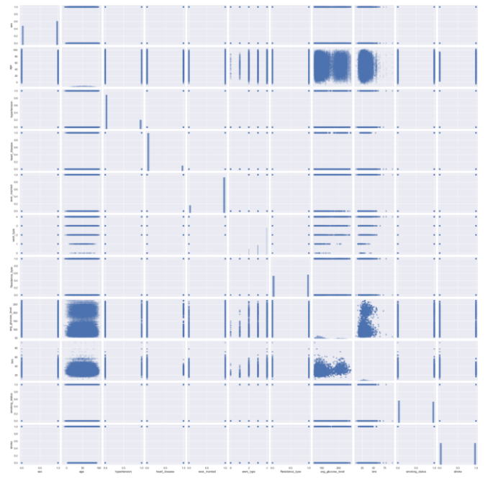
Data Exploration –PAIR PLOT

Slide 8

Data Modelling
We are going to explore 3 models
Logistic Regression
K-Near Neighbours
Random Forest
As grid search cv finds best fits for the data , we
using it.

Slide 9
Logistic Regression
Logistic Regression models the probability of a binary outcome using a sigmoid function.
It’s interpretable and includes regularization (L1 or L2) to prevent overfitting.
Used for tasks like predicting disease presence or customer churn, it balances simplicity and performance effectively.
In our analysis, the best parameters included C: 0.1, penalty: l1, and solver: liblinear.

Slide 10
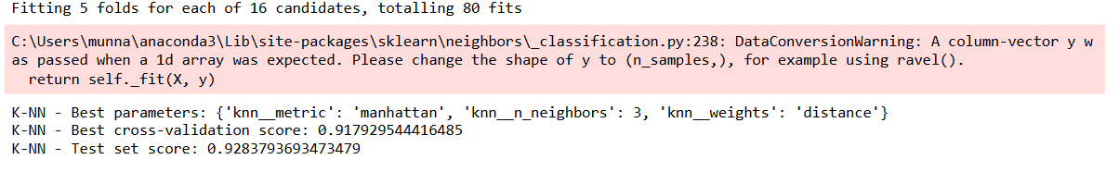
K-Near Neighbours
K-Nearest Neighbors is a non-parametric algorithm that classifies data points based on the closest training examples in the feature space.
It’s straightforward and intuitive, working well for both classification and regression tasks. K-NN leverages distance metrics (like Euclidean or Manhattan) to find the 'neighbors' and makes predictions based on majority voting.
In our analysis, the best parameters included metric: Manhattan, n_neighbors: 3, and weights: distance.

Slide 11
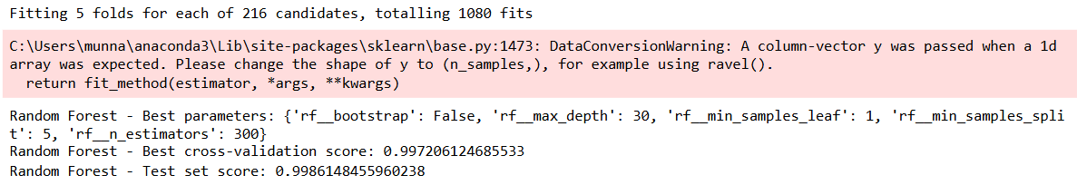
Random Forest
Random Forest is an ensemble learning method that constructs multiple decision trees during training and outputs the mode of the classes for classification tasks.
It’s robust against overfitting and works well with large datasets by capturing complex interactions between features.
The method is versatile, handling both numerical and categorical data, and it provides feature importance insights.
In our analysis, the best parameters included bootstrap: False, max_depth: 30, min_samples_leaf: 1, min_samples_split: 5, and n_estimators: 300.

Slide 12
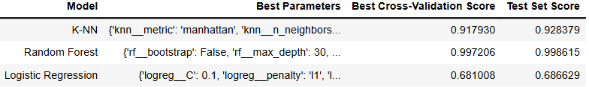
Evaluation
Logistic Regression achieved a cross-validation score of 0.681 and a test score of 0.687, providing clear probability estimates but struggling with complex relationships.
K-Nearest Neighbors (K-NN) scored 0.918 in cross-validation and 0.928 on the test set, excelling in clustering but being computationally expensive.
Random Forest outperformed both with a cross-validation score of 0.997 and a test score of 0.999, showing robustness against overfitting and capturing complex interactions, making it the preferred model for its superior accuracy and resilience.

Slide 13
Key Insights and Findings
Based on accuracy and performance, the Random Forest classifier is recommended. It provided the highest cross-validation and test set scores, indicating strong predictive power and robustness to overfitting.
From heatmap, work_type and residence_type has less impact on storke prediction

Slide 14
Future Goals
Limitations: The model's performance is excellent, but overfitting might still be a concern. Further validation with external datasets is recommended.
Next Steps:
Feature Engineering: Introduce new features, like family medical history or lifestyle habits, to improve the model.
Longitudinal Data: Use time-series data to track patient health metrics over time.
Model Ensembles: Experiment with stacking or blending different classifiers to enhance predictive performance.

Slide 15
Conclusion
This analysis showcases the strength of Random Forests in handling complex datasets with a mix of categorical and numerical variables.
The insights derived can significantly impact early stroke prediction and prevention strategies.

Slide 16
Thank you for your time
Have a Great Day 😊
My LinkedIn: Kundhan Miriyala|LinkedIn

